Slide 1
Image Restoration using Masking and Inpainting
Name: Utkarsh Raj
Roll no: 22CS2024
Supervisor Name: Dr. Susham Biswas

Slide 2
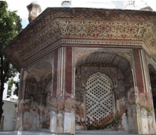
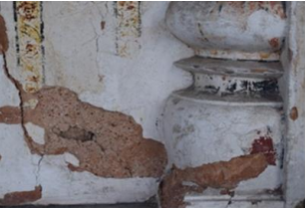
Problem Definition
Objective: Restore images by leveraging masking and conventional inpainting techniques,to effectively reconstruct missing or damaged regions with realistic and seamless results.
Challenges in Image Restoration :
Physical Damages:
Scratches, stains, tears in old photos.
Unwanted Elements:
Text, logos, or objects disrupting images.
Corrupted Data:
Compression artifacts, noise, or missing sections.
Traditional Methods:
Struggle with seamless texture and structure restoration

Slide 3
Proposed Solution
Utilize masking to identify damaged areas and apply conventional inpainting to restore them.
Masking:
Generate a binary mask to specify regions needing restoration.
Masks are manually created or automatically detected using segmentation models.
Inpainting Process:
Use a conventional inpainting method by averaging the pixel values of neighboring non-masked regions
to reconstruct missing content, ensuring seamless integration with the surrounding image.
Post-Processing:
Smooth the transitions between restored and original areas.
Enhance image quality using sharpening or blending filters.

Slide 4
Workflow
Input Image
Preprocess the image to standardize size, format, and quality.
Mask Generation
manually extract the pixel values to identify and isolate the given damaged or missing region in the image.
use the average of neighboring non-masked pixels to reconstruct the missing or damaged regions of the image.
Inpainting Model
Post-Processing
Refine inpainted regions for seamless integration.
Output Image

Slide 5
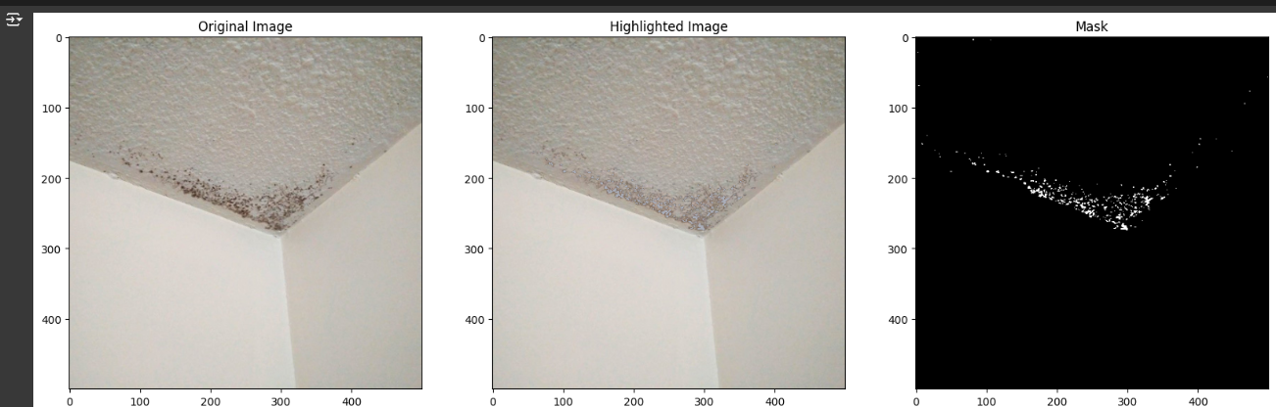
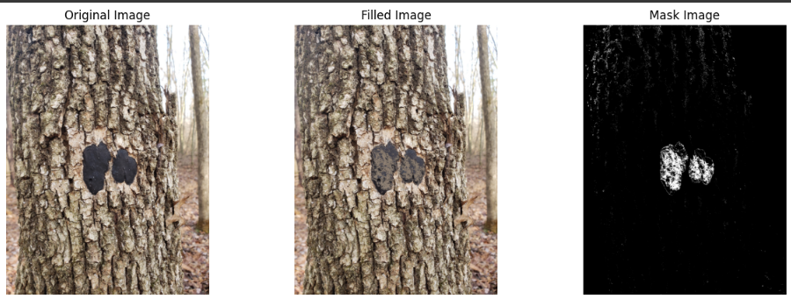
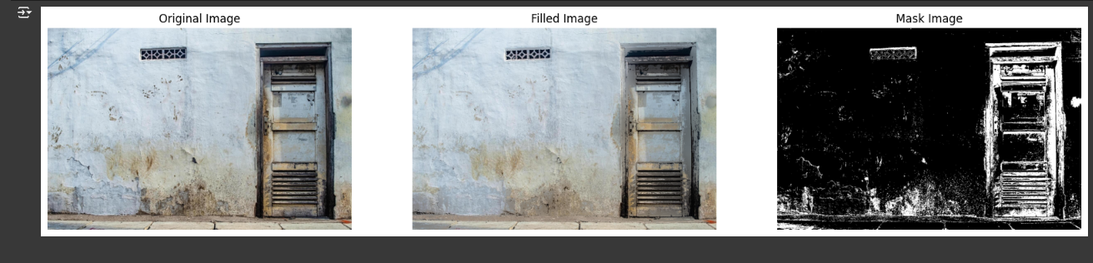
Results and Demo
Room ceiling
Tree Bark
Dirty Wall

Slide 6
Future Scope
Enhanced Masking Automation:
Develop automated techniques for accurate mask generation using segmentation models.
Improved Inpainting Methods:
Incorporate advanced algorithms to handle complex textures and patterns.
Real-Time Restoration:
Optimize the process for faster, real-time image restoration applications.
Scalability:
Extend the approach to work with higher-resolution images and 3D image datasets.
Broader Applications:
Apply the methodology to medical imaging, satellite imagery, and video restoration tasks.
Integration with Deep Learning Models:
Explore hybrid methods that combine conventional techniques with AI-based inpainting for better results.

Slide 7
Thank You

